Slide 1


Prevention of the Fatigue Crack Propagation Mode of Failure in Welded Components and Structures.
A lecture, investigating the failure mode of welded components and structures, if aspects of overload are ruled out, when, subsequently, the most likely mechanism of failure to come into consideration is that of fatigue.
Lecture by DR E. J. FRANCE --- M.WELD.I --- FIMMM --- C.Eng.

Slide 2
Purpose of This Lecture.
In addition, to the scientific content of this lecture, it contains essential information that is especially targeted at the designer of welded structure, as well as, at other scientists and engineers. Further, it is the “purpose” of this lecture, also, to show the designer what must be physically carried out correctly, in order, to obtain maximum “functionality” from the resulting welded structure and its design.
The lecture will also reveal the sad fact that designers have never received a welded structure that gives maximum functionality, exemplified by the premature / catastrophic failures that have happened over the years, derived especially from fatigue phenomena, for example, the failure of the Alexander L. Kielland Oil Platform in 1980 by fatigue crack propagation mechanisms coming into being and operating.

Slide 3
The Most Important Facts To Remember Regarding Welding Engineering.
Welding engineering is an empirical science, only, it is not a pure science. The statement means that it is inevitable one needs to develop and qualify weld procedure for application to fabricate a welded structure, this is fundamental to the subject and discipline. It is non-scientific therefore and complete nonsense to advocate one can apply welding processes to any joint without reference to a weld procedure and expect the right result. ( By comparison, it is nonsensical to say, I do not need to breathe to be alive as a human being ).
A welded joint consists of a material condition, such as microstructure in pure metal and metal alloys, together with a physical condition, such as fusion characteristics, both conditions with their associated imperfections.
The objective for all welding personnel in welding engineering is to deliver “as welded” what is known as “The Common Objective”, which is a welded joint with the lowest level of imperfection in its material and physical condition.

Slide 4
A Working Definition of Premature/Catastrophic Failure Derived from Fatigue, for a Welded Component and or Structure.
The working definition of a catastrophic failure to be used in this lecture / presentation is as follows :-
“A catastrophic fatigue failure is where a welded component and or structure suffers premature lack of function, in relation to its designated design life, derived from fatigue crack propagation mechanisms that come into being and operate”.

Slide 5
The Objective of this Investigation is to Examine, What it is Understood to be Fact Behind the Conjecture and or Currently Held View, That Fatigue Forms a Major Source of Failure of Welded Structures.
If we can successfully delve into the facts concerning the fatigue failure of welded structures and indeed components, then it should provide the opportunity to derive improved preventative measures during the welded construction phase of a product.
Research of the scientific literature suggests that there is, in general, three distinct modes of failure of welded structures. These are the following:-
--- No.1 --- Overload - which includes plastic deformation aspects and or features of brittle fracture.
--- No. 2 --- General and localised corrosion of structure – suggested as leading to genuine overload ( from loss of cross section) and or corrosion fatigue phenomena.
--- No. 3 --- Fatigue crack propagation mechanisms that come into being and operate.

Slide 6
The lecture is therefore focusing upon aspects of those features of “fatigue behaviour” which can be influenced such that the welded structure, has the ability, to survive service conditions for the designated design lifetime.
Question : What are these aspects of fatigue that we need to investigate?
Answer: These aspects are termed “Defective Origins” and to define them further : if these “Defective Origins” are prevented from coming into existence during the construction phase, then the welded structure has the highest probability of surviving the designated design and working lifetime.
Question: What does this fabrication requirement impose upon and mean for the designer of the welded structure?
Answer : The designer must be confident and assured that certain design assumptions can be made, i.e. without these “Defective Origins“ completely undermining the working performance of the welded structure. Any designer should be able to and be entitled to make assumptions for their design to function satisfactorily, however, the “Defective Origins” must be absent in the welded structure.
Let us now investigate the 3 modes of failure in terms of “Defective Origins”.

Slide 7
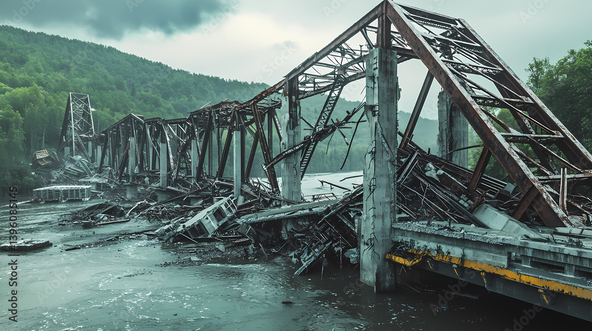
Mode of Failure : --- No.1 --- Overload : This Mode of Failure Can be Associated with Plastic Deformation Effects and or Complete Brittleness. --- Below, Plastic Deformation Effects Due to Loading Beyond the Yield Point of the Structural Steel.

Slide 8
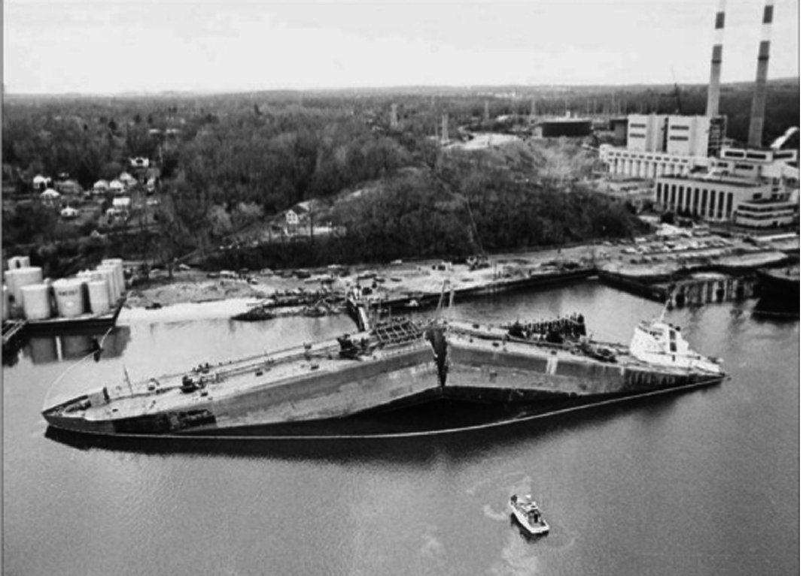
Mode of Failure : --- No.1 --- Overload : Brittle Failure of a Liberty Ship Due to the Steel of Construction not Possessing Toughness at Service Temperatures Below 0º C.

Slide 9
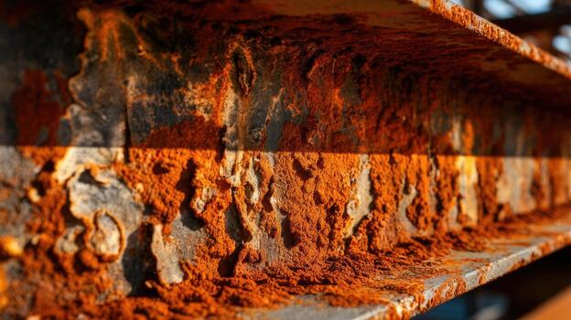
Mode of Failure : --- No. 2 --- Corrosion : Derived from General Corrosion, Failure Would be from Overload Due to Loss of Load Bearing Cross Section of Welded Joints and the Parent Product Forms of Construction.
General corrosion on a steel beam showing gradual loss of load bearing cross section.

Slide 10
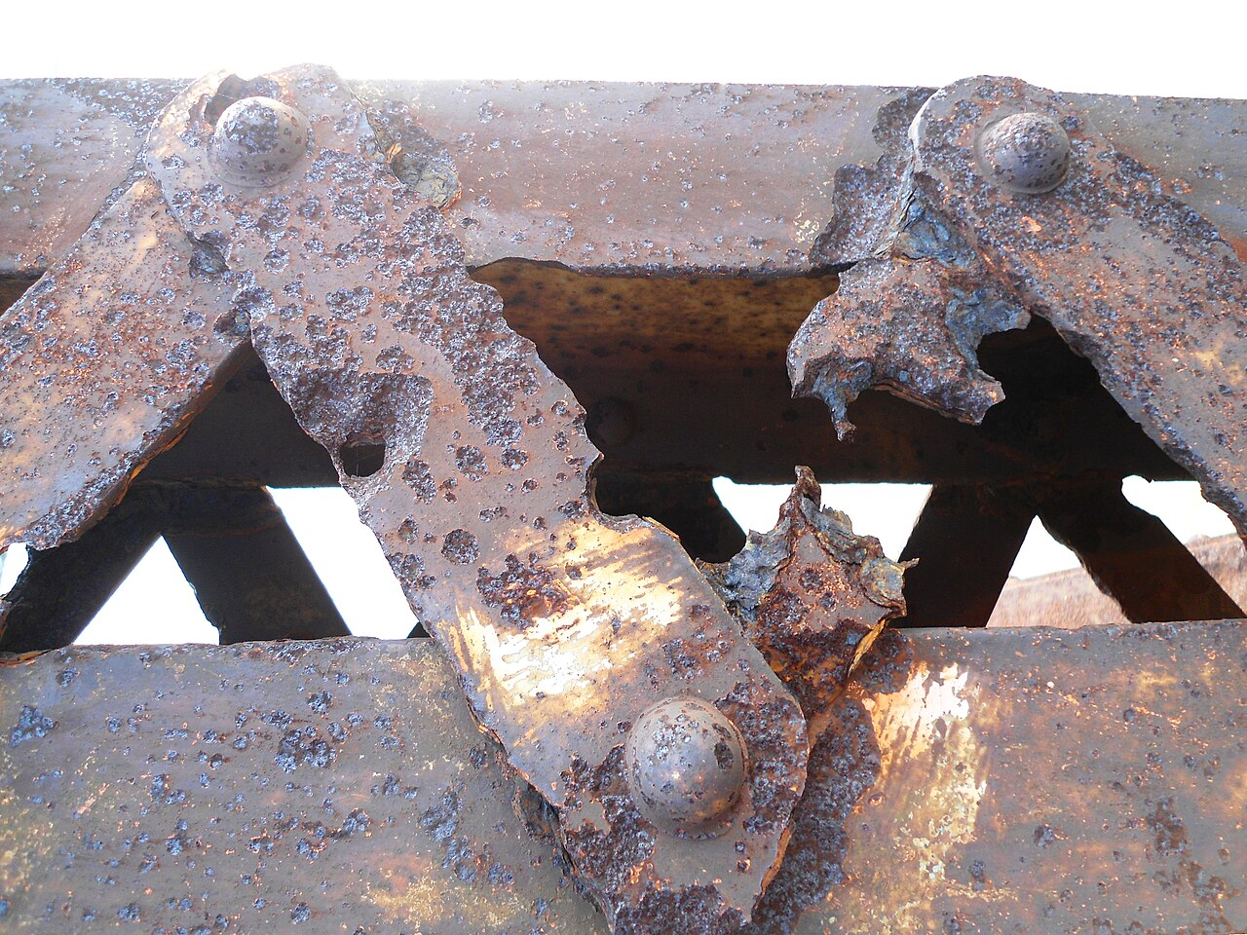
Mode of Failure : --- No. 2 --- : Corrosion : Derived from Localised Corrosion, for Example :- “Pitting Corrosion”, Failure is from Localised Loss of Load Bearing Cross Section Associated with Fatigue Crack Propagation Mechanisms Coming into being and Operate.
Pitting corrosion of structural carbon steel and subsequent creation of defective origins for fatigue crack propagation failure.

Slide 11
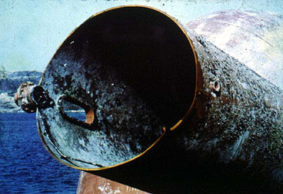
Mode of Failure : --- No. 3 --- Fatigue : Failure is Derived from the Defective Origins Created When Welding the Fabrication is Initially being Carried Out, These Structural Features then Behave as Local Stress Raisers for Cracks to form and the Fatigue Crack Propagation Mechanism to Come into being and Operate.
Position of the defective origin on Brace D6 , the hydrophone joint, on the “The Alexander L. Kielland Oil Platform”, where a fatigue crack propagation mechanism had come into being and became operative.

Slide 12
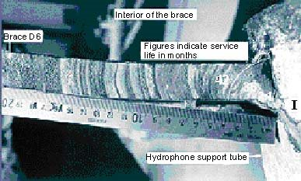
Mode of failure : --- No. 3 --- : Fatigue : Close up photograph of the hydrophone insert fillet welded joint on Brace D6, “The Alexander L. Kielland Oil Platform”, showing the features of the “created defective origin” derived from applying the welding process, deliberately incorrect. --- A “stuck together” welded joint is produced, of weld quality being unknown.
The actual position of the defective origin is the root of the fillet weld where there is no fusion, but also, it owns the presence of hydrogen induced cracks. Beach marks on the fracture face of the propagating fatigue crack showing its direction of movement around the circumference of the Brace D6.

Slide 13
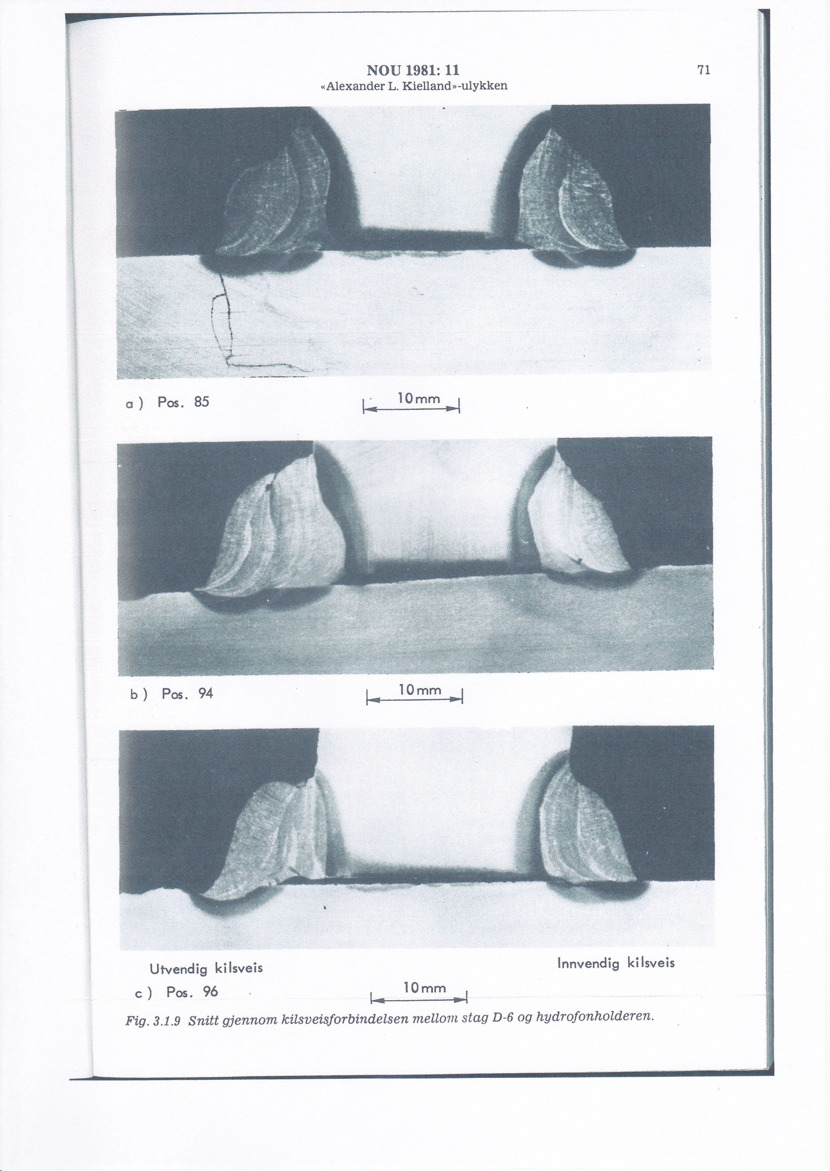
Mode of Failure : --- No. 3 --- Fatigue : Macro Section at Position 85, Through the Remaining Attached Fillet Weld on the Hydrophone Joint of Brace D6 of the Alexander L. Kielland Oil Platform, Showing the Presence of Hydrogen Induced Cracks - These Cracks Prove the Oil Platform was in a Failed Condition “As Welded” in the Shipyard, Before Entering Service.
Position 85

Slide 14
At this Point, Let us Just List Some of the Weld Fabrication Standards and or Specifications, for the Manufacture of Welded Products, where a Design / Mechanical Engineer Uses Rules Laid Down in these Documents to Create a Designed Structure which when Fabricated will Survive the Designated Lifetime without Premature Failure.
Let us examine one of these documents, The AWS -- American Structural Welding Code, in more detail, with a view to illustrate how other standards / specifications, mentioned, actually, operate!
AWS API D1.1 --- It provides the design rules, weld procedure, welder qualification and inspection requirements for steel products such as the structural steelwork, of buildings, bridges, tunnel support sections and lifting equipment.
If the designers follow the “design rules”, if say for example, to the above standard / specification, could they make assumptions that the welded structure will give the designated design lifetime of service without premature failure from overload and or fatigue? An overall answer could be “YES” providing the qualified weld procedures were implemented in the manufacturing environment , shop and or site.

Slide 15
Examination of AWS API D1.1 Continued :
An overall answer could be “NO”, if the qualified weld procedures were not implemented in the manufacturing environment, shop and or site.
Question: What, then, has been and is now the “state of affairs” all over the world, regarding application of qualified weld procedures to manufacture welded products.
Answer : For the time of the last 50 years or so or maybe more, weld procedures have not been implemented satisfactorily, on the shop floor or site, anywhere in the world, this is a matter of fact, I am sad to point out. Therefore, are designers able to confidently say my fabricated design will not fail prematurely, say from overload ? Well , still a “YES”, as the working loads and stresses experienced by the welded joints are well below the yield point of the material of construction. However, because welders will have guessed the weld parameters and not delivered the required weld quality, Question : Is it that “welded defective origins” inevitably will be present in the product structure, Answer “YES” such that premature failure by a fatigue crack propagation mechanism operating becomes most likely to occur.

Slide 16
There are other Sections to AWS API D1.1 Structural Welding Code.
D1.2 --- covers Aluminium Alloy structures.
D1.3 --- covers structures in sheet steel.
D1.4 --- covers structures in reinforcing steel sections.
D1.5 --- covers structures such highly stressed bridges.
D1.6 --- covers structures in materials like stainless steel.
Something must be noticed which is common to all these individual specifications of the AWS API D1.1 Structural Welding Code and that is they all request as mandatary, construction using qualified weld procedures and welders coded / i.e. qualified to work with and apply these weld procedures to the product. What this infers is, compliance to the specification requirements means the “as welded product” has the optimum chance of surviving the designated design life, as it would be unlikely to contain active “as welded defective origins” that give rise to premature fatigue failures.

Slide 17
Other Design and Fabrication Standards and Specifications are:
ASME Code design sections : I, III, IV, VIII and IX
API 1104 Pipeline design
EN 1993 ( Eurocode 3 ) Design of steel structures
EN 1090 -2 --- Design and fabrication of steel structures
PD 5500 --- design and fabrication of unfired pressure vessels.
En 13530, En 12493 --- Design and manufacture of road going liquid gas carriers
Canadian Welded Steel Construction Code CSA 59
Plus : many more from countries all around the world but they all function in the same way as any and or other design and construction of welded structure, code, standard and or specification.

Slide 18
Question : At this Point, In the Consideration of Modes of Failure, To Consign a Verdict of Failure by Fatigue Upon a Welded Structure is and is not, Perhaps, Strictly Correct, Is it now ?
Answer : NO ! It is not correct. --- Because the role of the defective origin, whatever its actual nature and where it is derived from, be it from “ design, corrosion and or as welded aspects”, this term “an origin” seems to be a critical and “fundamental feature” of the fatigue failure. --- In other words, the fatigue crack propagation mechanism, apparently, cannot exist without the defective origin’s presence.
Therefore :- To finally define more accurately the third failure mode --- No. 3 -- Fatigue --- Instead of being termed “Fatigue” it should more scientifically and accurately be named “Fatigue Failure derived from Welded Defective Origins”.

Slide 19
For those Unfamiliar with Welding Engineering Science, A Technique to Visualise and Model how the Codes, Standards and Specifications Operate, For Production of a Welded Structure, Is to Consider and Understand what is Called “The Triangle of Actions”.
Design
Design and welded fabrication Effective inspection ensures the production
are inexorably linked together of a welded structure that will function
within the code, standard and satisfactorily for the design lifetime.
or specification. Following this triangular route delivers
functionality to the design.
Welded Fabrication Inspection
The Triangle acts to prevent the incurrence of various types of “Defective Origin” in a welded joint.

Slide 20
Designers ! --- An Important Point to be Made Here is the Role of Inspection when Implementing the Triangle of Actions.
Inspection will be carried out by the welding fabricator, as a natural course of action within that company, however, it has been proven this action of inspection has been found to be ineffective in delivering the required quality of welded joints for a structure. --- Fact, I am sad to report. What this means is the nature of inspection needs to be modified, by this way, of the following:- When a contract is placed with a welding fabricator, a certain type of inspection discipline must be made legal and mandatary binding, this needs to be incorporated into the contract for the work. Apart from the fabricator‘s inspection, the customer must employ their own inspection personnel who would be permanently working on the shop floor and or site, day to day. The role of these latter / customer inspectors is to regularly check the welders are working to the relevant qualified weld procedures for the product, --- the consequence of not doing this type of inspection is ! --- the designer can say “goodbye” to maximum functionality from their design.

Slide 21
Prevention of the three Main Modes of Failure of Welded Structures, That Could be Influenced by Fatigue Crack Propagation Mechanisms Coming into Being and Operating.
Mode of failure --- No.1 --- : Overload --- this mode of failure can be prevented by following the rules of the design section of a code, product fabrication standard and or specification. --- A design engineer can make a significant impact on the chances of the weld fabricated product giving the desired function for the designated design lifetime of service, when adhering to these rules. --- Usually, this latter feature of design is expressed as the maximum stresses to which the welded joints on the product are to experience in service, typically the working stress should be a fraction of the yield point for the alloy of construction. --- For example, the maximum working stress for the welded joints to accommodate, in UK designs of unfired pressure vessels to PD 5500, is Yield Stress divided by 5. --- Overload can certainly be prevented this way, however, the welded structure can still fail prematurely derived from design faults, e.g. shape features of joints, that will give rise to fatigue behaviour, a fundamental point being made here !

Slide 22
Mode of Failure --- No.1 --- Overload – Continued.
Referencing and using PD 5500 (UK) for this following statement : It is important for designers to realise that their design could still prematurely fail, i.e. not survive in service for the designated design lifetime, even though the conditions of service never exceed the material yield stress divided by 5. --- Premature failure, during normal operation conditions for pressure vessels, of this type is by fatigue crack propagation mechanisms coming into being and operating, derived from the presence of “welded joint defective origins”. --- This latter fact highlights the predominant importance of how welding processes are applied to fabricate a product, in this case, for an unfired pressure vessel designed and built to the requirements of standard PD 5500 (UK).
Note : A fundamental weakness of the manufacturing philosophy of PD 5500 (UK) is only a static hydro-pressure test is carried out on the vessel, there is no fatigue test requested from the specification !!

Slide 23
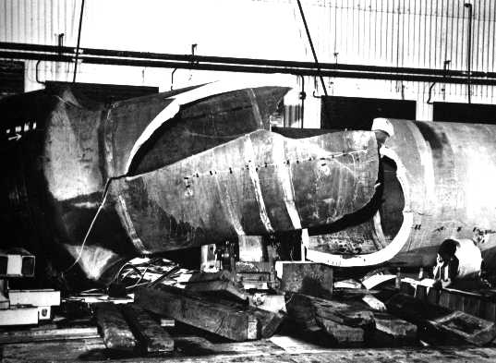
An Example of the Fundamental Weakness of the Manufacturing Philosophy of PD 5500 (UK) is the Failure Upon Hydrostatic Pressure Testing of a Pressure Vessel made at John Thompson Ltd in 1965. --- Look what Happened !
The as welded vessel was given a mandatary hydrotest which it passed but something was wrong with procedure such that the hydrotest was carried out several times. --- Effectively, the vessel was subjected to cyclic loading ( fatigue conditions) and failed by this mechanism due to inherent defective origins being present, in the form of inappropriate as welded and brittle microstructure. – Note : the brittle features of the steel wreckage.

Slide 24
Prevention of the Three Main Modes of Failure of Welded Structures Continued:
Mode of failure --- No.2 --- General and localised corrosion of structure.
This fatigue mode of failure can be prevented by suppressing the formation of “corrosion derived defective origins”, by for example : Using appropriate metal alloys, - or coating protection systems applied to the structure - like paint ! and or effective design innovations that facilitate such features as drainage and prevention of pockets in the design - that could contain and retain corrosive liquids - like chloride containing salts for example in contact with carbon steel.

Slide 25
Prevention of the three main modes of failure in welded structures continued:
Mode of failure : --- No.3 --- Fatigue : For a welded structure to suffer failure by fatigue, i.e. failure derived from a fatigue crack propagation mechanism , there is a fundamental requirement for a defective origin to be present. --- This fact is well established, in the science of metallurgy, when the subject is being taught on University courses.
Question : Where do the defective origins come from in a welded structure?
Answer : The defective origins are derived and produced from the way the welding process and or processes are applied to the joints.
Design engineers need to appreciate that application of a welding process, inevitably leads to the “incurrence” of all aspects of imperfection in a welded joint. The level of imperfection decides the acceptability of the welded joint.

Slide 26
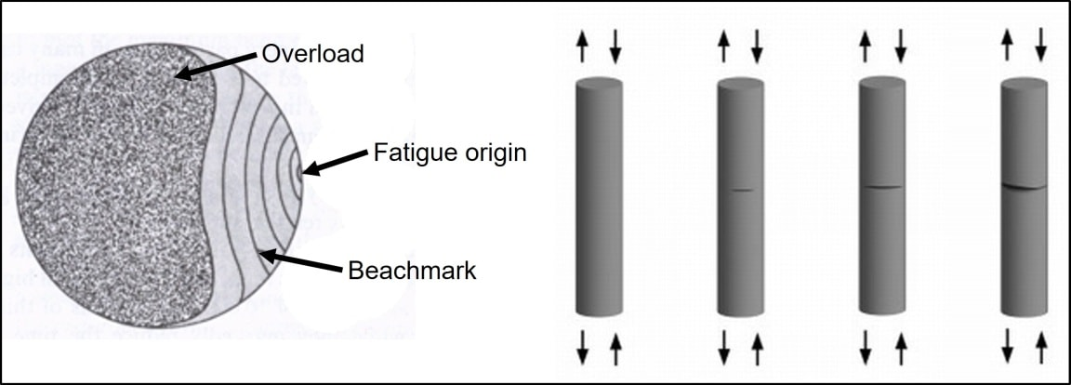
Schematic View of the Defective Origin’s Role in Fatigue Failure as Introduced to Students at a University.

Slide 27
Mode of Failure --- No. 3 --- : Fatigue Continued:
If, during fabrication of the welded structure, the level of imperfection cannot be suppressed and controlled adequately, the designer cannot make the assumptions that the welded joints will survive the designated design lifetime of service. --- By taking on board the naturally occurring problems from applying welding processes to joints , what can we do as welding engineers to give the designer the assurance that the weld quality in the joints will give the required lifetime of service without premature failure from fatigue? The answer is to use qualified weld procedures and welders, backed up with a regime of inspection, reference the Triangle of Actions. Note: all the design, codes, standards and specifications for welded structures ask for this welding requirement. Question : Nowadays, is the designer, in a position, to assume the welded fabrication has been carried out with these actions of qualification in compliance with the relevant code, standard and or specification.
--- Answer NO, I am sad to state. --- The reason stems from actions of welding fabricator company management who have broken the link in the Triangle of Actions between the design and welded fabrication.

Slide 28
What are the Preventative Measures then, That can be Implemented to Suppress the Occurrence of Fatigue Failure in a Welded Structure?
All design codes, standards and or specifications request the derivation and qualification of, weld procedure and hence the weld procedures and in addition, the welders, followed by the actual implementation of this skill in the manufacturing phase of producing the product. --- Question: Is this series of actions carried out universally and satisfactorily by welding fabrication companies, all over the world? Answer: I repeat, an emphatic NO !! and is a bombshell which designers must take on board. Without exception, welding fabricators do not apply the qualified weld procedures on the shop floor and or site, even in the production of welded pressure vessels. ( In the United Kingdom, non-compliant weld fabrication to the pressure vessel manufacturing code is breaking the law and is therefore a criminal offence ).
The first and general measure to implement, in order, to suppress fatigue mode of failure in a welded structure, is to force welding fabrication companies to behave themselves and be compliant with the relevant code, standard and or specification requirements. If this was to be achieved, then the designer could start to make the necessary assumptions for the “in service” stress calculations e.g. fatigue strength, to be accommodated and be acceptable so that required functionality is obtained.

Slide 29
How does Fabricating in Accordance with Qualified Weld Procedures Suppress the Likelihood of a Welded Joint Prematurely Failing by Fatigue in and Under Normal Service Conditions? In other Words, How is the link between Design and Welded Fabrication Maintained in the Triangle of Actions?
Answer to the question is as follows for the fillet, partial penetration and full penetration welded joints :-
The qualified weld procedure will deliver a surface profile for these welded joints to be convex but not exaggerated, in overall nature, to guarantee throat thickness and hence strength, whilst displaying relatively smooth appearance with minimum ripple. This means the welded joint is less likely to possess surface areas, that potentially produce stress raising effects, due to overall and or localised changes of shape.
In addition, the qualified procedure will deliver and confer to the welded joint satisfactory volumetric fusion characteristics such that internal stress raising effects cannot come into being, derived from inappropriate microstructure and or physical features.

Slide 30
At this Point in the Lecture, It is Important for the Designer to Understand and Take on Board, What is the Fact, That when Welding Processes are Applied to their Designs for Welded Structure Which are not in Accordance with Qualified Weld Procedure and not Using Coded Welders, They are Going to Receive what are known as “Stuck Together Welds”. Oh Dear !
The “ stuck together welded joints and structures” are inevitably full of defective origins that can initiate fatigue crack propagation mechanisms to come into being, exist and operate, this latter condition of welded structure is being produced in welding fabrication companies all over the world, without exception --- FACT !! I am sad to state.
Because of the latter statement being 100% and indisputably true, I must report to welded structure designers that they cannot rely upon the results of their stress calculations being accommodated by the production welded joints possessing the appropriate and desired mechanical properties. What follows are examples of the weld quality currently being produced from welding fabricators i.e. a quality containing potentially active and dangerous defective origins, suitable for fatigue mechanisms to come into being and operate.

Slide 31
Designers ! What Follows are Examples of the Weld Quality you are Currently Receiving in your Designed Welded Structures, Due to Welding Company Managements Breaking the Link between Design and Welding Fabrication on the Triangle of Actions. The Production of “Stuck Together Welded Joints” from Welding Fabricators Means they Possess these Characteristic Features, Both Material Fused and Physical.
Designers you should be shocked by what you are about to observe.

Slide 32
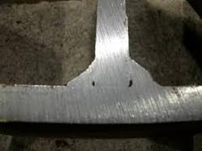
Application of a Welding Process, Not in Accordance with a Qualified Weld Procedure, Showing the type of Defect, i.e. Defective Origin, that Can be Incurred in a “Double Sided” Fillet Welded Joint. The Direction that the Fatigue Crack Propagation Will Take is from Inside the Joint to the Outside.
Joint preparation before welding. After welding.
Defective origin is lack of root fusion

Slide 33
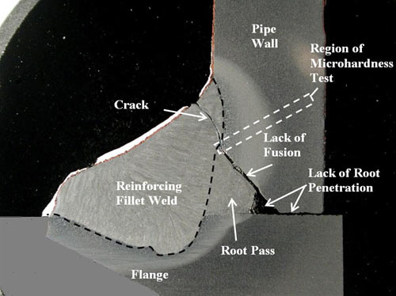

Application of a Welding Process, Not in Accordance with a Qualified Weld Procedure, Showing the Volumetric Incurred Defects, i.e. Defective Origins, In a Single Sided Partial Penetration “T” butt Welded Joint.
The defective origins manifest themselves in this partial penetration single sided “T” butt welded joint as lack of root fusion, the machined chamfer in the vertical plate is still present , i.e. not fused out, plus surface cracks in the profile. Failure from fatigue crack propagation will be from inside the joint outwards.
Joint preparation before welding. After welding.

Slide 34

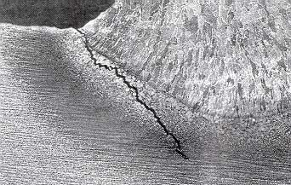
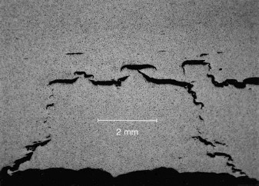
Internal Hydrogen Induced Cracking Due to Inadequate Application of a Qualified Weld Procedure in a Full Penetration Butt Welded Joint.
A full penetration butt weld with internal “as welded defective origins” that potentially could act as a stress raiser and bring into being a fatigue crack propagation mechanism.
Hydrogen induced cracks in the weld heat affected zone and parent metal

Slide 35
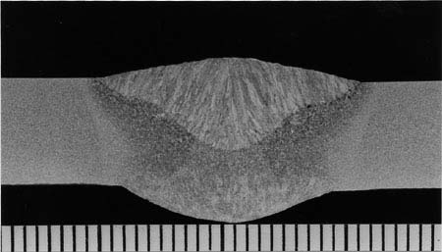
Implementing Qualified Weld Procedures with Coded Welders to Produce a Welded Structure, The Weld Quality Inherited Would be:- For Example, A Full Penetration Butt Welded Joint, With Smooth Convex Profile, Minimum Ripple and Appropriate Volumetric Fusion Characteristics. --- Both Inside and Outside the Joint there are no Undesirable Origins that could Initiate Premature Failure of the Joint from Normal Service Conditions, The Joint Possesses as Near as Possible a 100% Chance of Surviving the Designated Design Lifetime.
A double-sided full penetration plate butt welded joint, showing no unacceptable defective origins for fatigue.

Slide 36
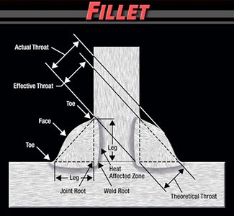
Image Shows the Desirable Fusion Characteristics of a Fillet Welded Joint with a Smooth Profile and Minimum Ripple. --- Both Inside and Outside the Joint there are no Undesirable Origins that Could Initiate Premature Failure of the Joint from Normal Service Conditions, The Joint Has as Near as Possible a 100% Chance of Surviving the Designated Design Lifetime.

Slide 37
By Applying Qualified Weld Procedures to Manufacture a Design for Welded Structure, The Designer will Receive Maximum Resistance to Fatigue Crack Creation and its Propagation Derived from the Welded Joints, The Chances of the Structure Surviving the Designated Design Lifetime will be Significantly Improved.
Question :If the above situation from the welding engineering point of view is now satisfied, is it that the designer is now able to make assumptions for the calculations of permissible working stresses?
Answer : Yes

Slide 38
Question : What Typically Could Design Engineers Assume in Their Stress Calculations for the Welded Structure Under Consideration, From the Fatigue Strength Point of View, Say for Example on a Carbon Steel Structure? Answer: With the Proviso Here that the Structure has been Welded in Accordance with Qualified Weld Procedures Required by the Code, Standard and or Specification for the Product. Typical Values of Fatigue Strength that can be Assumed for a Joint as Acceptable are Indicated Here.
MAXIMUM STRESS RANGE :- 2 x1,000,000 cycles
Fatigue strength required for calculation assumptions.
Alternating push – pull Repeating tension Description of the welded joint type
MPa MPa
± 140 ± 0 - 216 Full penetration plate butt
± 77 ± 0 – 124 Full penetration cruciform butt
± 35 ± 0 – 62 Fillet cruciform

Slide 39
What are the Related Welding Engineering Actions that have been Undertaken, Up to Date, To Try and Rectify the Situation of Vulnerability of Welded Structure Designs and their Fabrication, To Aspects of Fatigue Failure? --- Commentary Derived from Examples of the Past !
To answer the question, various fabrication standards and specifications, have been developed and published in the attempt to reduce the vulnerability of welded structure to aspects of fatigue.
By widespread introduction of standards such as e.g. ISO EN 13530, PD 5500 and ISO EN 3834 Parts 1and 2, as a mandatary requirement for a welding fabricator to be certified to and permitted to manufacture certain welded products, for example, road going liquid gas carriers, running gear for wheel axle assemblies, autoclaves for use in hospitals. These standards contain all the relevant requirements for the welded structures to be produced, be fit for purpose and to deliver the designated design life. Question : Do the fabricators of such equipment comply with the welding requirements of the standards? Answer : NO - because of the company management breaking the link between design and welding fabrication of the Triangle of Actions. --- In the United Kingdom, non-compliance to specification PD5500 and ISO EN 13530 in any way, is breaking the law, i.e. The Pressurised Equipment Safety Regulations (Great Britain) and would require prosecution, yet ! still the management of these fabricators of such equipment deliberately do not comply – FACT I am sad to report. Why is this so? --- Quality assurance auditing is useless and totally ineffective.
All the organisations and committees involved in drafting these standards do not appreciate the consequences of non-compliance, to what they state as mandatary to carry out and further, how it affects the fatigue behaviour of the welded structure produced, --- this is to the disappointment of any professional welding engineer worth his salt, as the expression goes!

Slide 40
From the Information Presented Here in this Lecture, What are the Conclusions Designers of Welded Structure Must Take on Board and then Subsequently Question : “Is it Possible for Rectification of the Situation of Non-Compliance Carried out by Welding Fabricators?”
Conclusions.
--- 1 --- Question : As of today, can designers of welded structures make assumptions that the welding fabricators will deliver welded joints that have the desired mechanical properties, such as UTS, Rp0.2, % ductility, toughness value and fatigue strength, so that the designated design lifetime will be satisfied. Answer : NO !! The reason being that welding fabricators all around the world do not implement the qualified weld procedures in shop and or site during manufacture. Further, this misbehaviour shows complete contempt for the mandatary requirements of the code, standard and or fabrication specification for a welded structure.
--- 2 --- Because of this misbehaviour by the welding fabricators, of not implementing the use of weld procedures on the shop floor and or site, failure of a welded structure is most likely to occur by fatigue crack propagation mechanisms coming into being and operating. The reason for this latter fact is that by these actions by welders and welding fabricator management, the welded structure is inevitably full of “ As Welded Defective Origins”. These origins act to create nucleation sites for stress raising activity within the joints and then permit crack propagation mechanisms to commence, under cyclic load.

Slide 41
Conclusions Continued :
--- 3 --- Experienced welding engineers have tried to implement the necessary welding engineering “Triangle of Actions”, plus, quality assurance auditors have audited and given certification to welding fabricators, with the objective of trying to force the fabrication companies, without success by the way, to comply and implement the use of qualified weld procedures in accordance with the requirements of the relevant code, standard and or specification for the product. Today, the latter is fact ! --- Question : Why is it that welders and especially the management of welding fabricators deliberately do not comply with the requirements for welding the product. Answer: The reason is explained from complete ignorance and no understanding of welding science and by financial greed with the notion they will not get caught and they can cover their tracks. These managements have no conscience, do not consider the consequences of their actions and put profit before the health and safety of human beings.
--- 4 --- And so designers, what can you do about this situation to help yourselves and ultimately receive the fabricated design you desire? You as designers must enforce in some way the execution of the Triangle of Actions.

Slide 42
Designers then – Question : What can you do Better than what has been Tried Already, To Positively Influence the Behaviour of Welding Fabricator Management in the Right Direction ?
--- 5 --- Answer: It has been tried before by deriving design and fabrication, codes, standards or specifications, coupled with the attempt to introduce them to the manufacturing environment, via Rules , Regulations and Quality Assurance. --- However, the result of these actions, e.g. especially derived from auditing, has been complete failure to have products welded to qualified weld procedures on the shop floor or site, i.e. to adequately prevent fatigue in all its aspects. The latter situation has been in existence for 50 years or more , with vital lessons not learnt and or ignored by fabricator management.
Who has the power then to rectify the problem? i.e. to force the fabricators to behave and comply with the requirements, well, responsibility falls upon the designers who are the creators of the designed welded product. At first, the designers’ reaction may be defensive, who me? but you can enforce how the manufacturing of your design is carried out, as you are going to pay the bill, so to speak. The technique is to bring about the rigorous implementation of policing of the manufacturing operation and make these required actions legally mandatary, the fabricator must be made to realise if there is no compliance then no payment will be given. Best of luck in pursuit of this objective.

Slide 43

Contact Us
Edwin James France
Independent Welding Engineering Consultant
UK
Email: enquiries@ejfranceconsulting.co.uk
❖ Published by:
❖ Journal of Oil, Petroleum and Natural Gas Research
❖ Scientific Research and Community
❖ E-mail: petroleumtechnology@onlinescientificresearch.info

